Slide 1
Module 2
NUT 3700: Nutrition Education and Counseling

Slide 2
Nutrition In the News

Slide 3
Review from last week
Introductions
Active Listening
First presentation (2 groups at 2 boards)

Slide 4
TODAY’S PLAN
OBJECTIVE:
Build skill for developing and implementing group educational sessions or programs

Slide 5
Beginning
What presentations and group education classes will you be giving/leading in the future?
What have been your best and worse experiences with these so far?
Line-up according to comfort level with leadership through public speaking.

Slide 6
Toastmaster Videos: Effective Presentations
http://www.toastmasters.org/Resources/Video-Library/knowing-your-audience
http://www.toastmasters.org/Resources/Video-Library/keeping-your-audience-engaged

Slide 7

Resource/Collaborator Presentation
What questions do you have?
Rubric
“Dietitian’s Pocket Guide to Nutrition”
Topic Sign up sheet: note your presentation date

Slide 8
Adult Learning
What were some of your favorite classes/presentations? Why are they your favorites?
What kind of learner are you? How will this apply in this class?
Key Components
Motivation
Experience
Level of Engagement
Applying the Learning
Learning Styles
Barriers to Learning

Slide 9
Adults bring experience; have things to share; have things to lose
Encourage questions and discussion from their experience.
Don’t just present the “truth.” Allow them to arrive at their own “truth.”
  “Can I eat the cake at my Granddaughter’s party?”
Adults don’t want to risk looking stupid.
  “Drinking raw milk cured my cousin’s diabetes.”
Adults do want feedback on progress and to know how they can improve.
  Summarize and provide assessment along the way
  “So far we’ve…”

Slide 10
Adults prefer to focus on real-life over theoretical concepts
What they learn must have personal meaning and be of direct value.
  Tailor topics to the audience
  Share reasons and benefits of the class
  Summarize regularly to show progress

Slide 11
Accustomed to being self-directing
Adults learn by doing and making mistakes and then discovering solutions for themselves.
Adults want to be consulted and listened to.
Although trainers need to give direction at times, this should be the exception rather than the rule.
Humans are natural problem solvers – make it so they find their own solutions

Slide 12
Questions
You’re planning to present to a group of people who have recently survived heart attacks. The lesson plan for the evening is label reading. Someone asks, “Should I eat butter or margarine?” several others are nodding as though they’re wondering the same. You should:
  Go ahead with label reading as planned and let them know you’ll be covering fat later on.
  Ask the rest of the group whether it’s okay to switch gears and talk about fat for part of the time tonight.
  Go with your feeling that everyone is onboard with the switch and start talking about fat.
You’re presenting to a group of people recently diagnosed with type 2 diabetes. Someone asks, “Can I have a piece of birthday cake at my granddaughter’s birthday party?” The best response would be:
  “Of course! You can have a small piece. Just be sure to account for it in your insulin dose.”
  “Well no, I would not recommend it. You should stay with the consistent carbohydrate plan we developed together.”
  “I have an idea. We could plan an experiment that helps you decide whether or not having cake in these situations is right for you. What do you think?”

Slide 13
Addie Model
Analyze
Design
Develop
Implement
Evaluate
https://www.youtube.com/watch?v=JZdv5lrJs4U

Slide 14
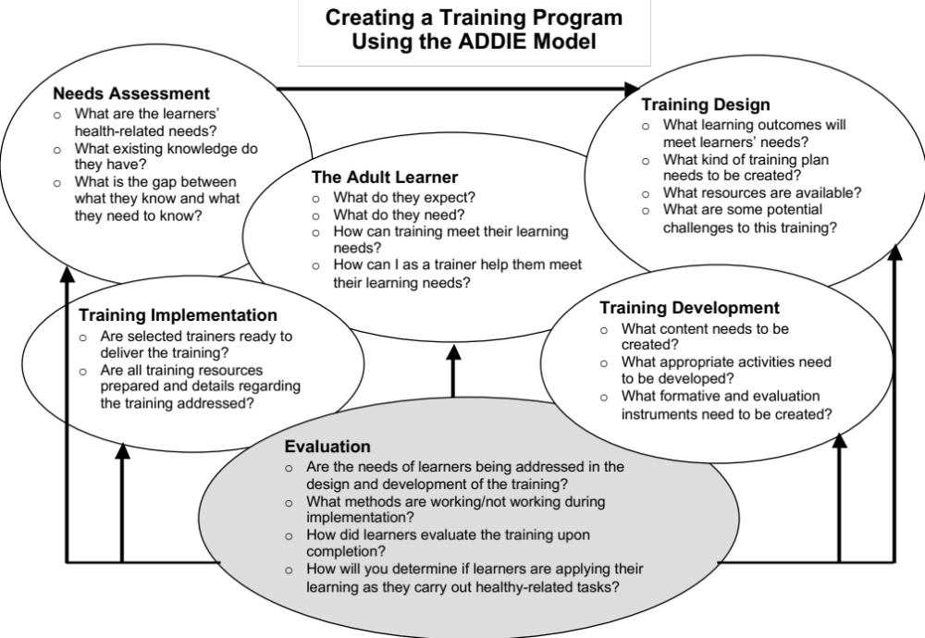

Slide 15
Warm up question: Using the ADDIE model, outline steps you would take to plan a group education program for Native Americans on preventing diabetes-related complications.

Slide 16
Activity Break
https://www.youtube.com/watch?v=-0k_URgPpLI

Slide 17
Beginning with the End in Mind - Writing Smart Learning Objectives
Learning objectives should be:
  Consistent with the goals of the educational program
  Clearly stated
  Clearly measurable
  Realistic and doable
  Appropriate for the level of the learner
  Worthy (important stuff)
Why start with objectives?
Bloom’s Taxonomy may be helpful when writing objectives.
Notes:
By knowing where you intend to go, you increase the chances of you and the learner ending up there
Guides the educator relative to the planning, delivery and evaluation of participant learning
Guides the learner; helps him/her focus and set priorities

Slide 18
Which learning objectives are most effective?
1.a. Know how to read labs. | 1.b. Plan corrective behaviors based on too high phosphorus labs.
2. a. Make low sodium selections from sample restaurant menus. | 2.b. Learn which foods are high in sodium and which are low in sodium.
3.a. Understand about high blood pressure. | 3.b. Compare and contrast the various methods for reducing blood pressure.

Slide 19
ADDIE Practice
Group Nutrition Education Planning Exercise
Work in groups to walk through the ADDIE model for a hypothetical audience.
Each group needs:
  Recorder
  Creativity director
  Encourager/equalizer who makes sure everyone contributes. The encourager decides who presents.
  Task master who makes sure the group gets started quickly and moves efficiently through the project
  Learning objective specialist who reads and helps the group understand that document/task
Be prepared to share your ideas with the class.

Slide 20
Empowerment Approach
Step 1: Explore the problem or issue.
Step 2: Clarify feelings and meaning.
Step 3: Develop a plan based on collaborative ideas.
Step 4: Commit to a specific action.
Step 5: Experience and evaluate the plan. How did it go?

Slide 21
article on innovations in group education strategies for diabetes self-management.
What are the innovations in group education described in the module article?
T or F. This is on the final exam.

Slide 22
innovations in group education strategies
Capitalize on opportunities to provide education
No formal curriculum: Problem-based group
Basic Education plus “forever” come as needed problem-based group
Final exam and table 3 from the article

Slide 23
Review:
Giving great presentations…
The first assignment presentation
ADDIE model
Innovative approaches

Slide 24
Wrap Up – 1 minute essay
What are some things you learned today that will benefit your future practice?
What is your vision for the resource/collaborator presentation?
What questions do you have regarding the material we’ve covered?

